Slide 1
WEB222 - Web Programming Principles
Week 10: HTML Forms
& Form CSS Styling

Slide 2
Agenda
Introduction to Form
<input> tag
Text Fields in a Form
Selection Fields in a Form
Form Buttons
Styling HTML Forms Using CSS
More on CSS Selectors

Slide 3
HTML Forms
HTML forms are web page components that are used to collect user input.
An HTML form can contain input elements / form controls, such as:
input fields, text area, buttons, checkboxes, select lists, fieldset, legend, and label.
HTML forms are originally used to pass data to a server.
The client fills out some information and then the browser sends the data from the form fields to the server for processing.
For front-end web application, HTML forms can also be used for in-browser Processing (without sending data to server).

Slide 4
HTML Forms
Examples
Oracle User Registration
simple-form.html

Slide 5
The <form> Element
The <form> element defines an HTML form:
<form id="formId" method="...."
action="url" >
…. …
</form>
HTML forms contain form elements (or form controls).
A document may have more than one form, but forms cannot be nested.

Slide 6
Attributes for <form> - method
The method attribute
It declares the HTTP method that the browser uses to send/post the form data to the server.
method="get" :
is the default. The fill-out form contents to be appended to the URL as if they were a normal query (maximum of 256 characters).
Example: simple-form.html
method="post" :
the fill-out form contents to be sent to the server in a data body rather than as part of the URL
Method "post" is more secure.
Example: simple-form-post.html
Notes:
In-browser Processing VS Web App Processing
In-browser Processing :
The following can be used as a template for a form that has in-browser processing:
<!-- somewhere you will have a JavaScript function -->
<form>
<input type="text" name="username" />
<input type="password" name="password" />
<input onclick="login();" type="button" value="Login" />
</form>

Slide 7
Attributes for <form> - action
The action attribute tells browser where to post the form data when the form is submitted.
action="url"
Normally, a form is submitted to an URL on a web server.
Examples
<form id = "example1" method="post"
action="https://formpost.azurewebsites.net/home/test"> … </form>
The URLs for testing your forms:
https://formpost.azurewebsites.net/home/test (not for ‘get’, local)
https://httpbin.org/get (for ‘get’ method, JSON format)
https://httpbin.org/post (for ‘post’ method , JSON format)
action="#"
Submit to current page, used for in-browser Processing

Slide 8
Form Elements
An HTML form can contain a number of form elements/fields/controls:
The <input> element is the one of the most-used form element.
Other form elements which are used gather or process user’s input:
<select>, <textarea>, <button>.
Other elements that can be used in forms:
<fieldset>, <legend>, <lable>, …

Slide 9
The <input> Elements
The <input> tag is used to specify a simple input element inside a form that can receive user input.
<input> tags are inline, empty tags . It may be written as <input />
type attribute.
The type indicates what sort of input field the tag represents, such as text boxes or radio buttons.
By default, type="text“.
name attribute
All <input> tags are required to have name attribute and value, except for the submit and reset buttons.
Without name attribute, the user’s input for this input element will not be sent to server.

Slide 10
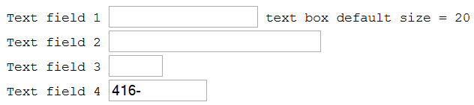
Type Attributes of the <input> Tag
type="text"
A text element is a single line text input field in which the user can enter text.
type="text" is default for the tag.
Other attributes for this type: size, maxlength
Text field 1 <input type="text" name="entry1" id="entry1" />text box default size = 20<br />
Text field 2 <input size="30" maxlength="10" name="entry2" id="entry2"/><br />
Text field 3 <input size="5" maxlength="10" name="entry3" id="entry3"> <br>
Text field 4 <input size="12" value="416-" name="entry4" id="entry4" >
input-tags-1.html

Slide 11

Type Attributes of the <input> Tag
type="password“
A password element is a text input field in which each character typed is displayed as a character such as * or a black dot to conceal the actual value.
Type in your username <input name="username" /> <br />
Type in your password <input type="password" name="password" />

Slide 12
Type Attributes of the <input> Tag
type="hidden"
A hidden input element is an invisible element whose main purpose is to contain data that the user does not enter. This data gets sent to the invoked server program when the form is submitted.
The type="hidden" attribute provides a way for delivering a value to server program
<input type="hidden" name="entry0" id="entry0" value="value from the form" />

Slide 13

Type Attributes of the <input> Tag
type="file"
A file element allows the user to supply a file as input. When the form is submitted, the content of the specified file is sent to the server as the value portion of the name/value pair for this input element.
A 'Browse' button is displayed next to the file input element that lets users select a file from their system to use as the value of the file input element.
If a form contains a file input element, the value of the enctype attribute of the form tag should be 'multipart/form-data'.
Student Name <input type="text" name="StudentName" id="StudentName"><br>
Upload your assignment <input type="file" name="assignment" multiple>
Notes:
Type=file can have multiple attribute to work with

Slide 14

Type Attributes of the <input> Tag
type="button"
<input type="button" value="Press This Button" />
type="image"
Places an image, serving as a custom button in place of the submit button. When a user clicks the image, the form is submitted to the server.
Search <input type="text" name="entry6" id="entry">
<input type="image" src="gogetit.gif" alt="get it">
input-tags-1.html gogetit.gif

Slide 15

Type Attributes of the <input> Tag
type="submit"
When a user clicks a submit button, the form is submitted to the “url” specified by the action attribute of the form.
If no value attribute: “Submit Query” will show on the button.
type="reset"
When a user clicks a reset button, all elements in the form are reset to their original
Default value for value attribute: “Reset”.
<p>
<input type="submit" value='Submit’ >
<input type="reset" value=" Clear ">
</p>

Slide 16
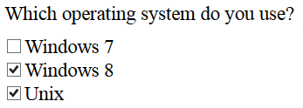
Type Attributes of the <input> Tag
type="checkbox“
A checkbox element is a toggle that the user can select (switch on) or deselect (switch off.)
All checkbox items should have the same name indicating they are in the same group.
Notes: 1. <input> tag is an empty tag. 2. the name and value must be specified so that the name and value pair can be sent to server.
input-tags-2.html
<p>Which operating system do you use? </p>
<input type="checkbox" name="system_type" id="stype-2" value="2" />Windows 7<br />
<input type="checkbox" name="system_type" id="stype-3" value="3" checked>Windows 8<br>
<input type="checkbox" name="system_type" id="stype-4" value="4" checked/> Unix<br />

Slide 17
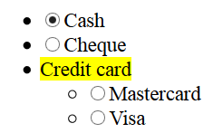
Type Attributes of the <input> Tag
type="radio"
A radio element is a radio button.
Only one radio button in the set can be selected at one time..
All radio button items must have the same name indicating they are in the same group.
<ul>
<li><input type="radio" name="paymethod" id="paymethod-1" value="cash" checked />Cash</li>
<li><input type="radio" name="paymethod" id="paymethod-2" value="cheque" />Cheque</li>
<li><mark>Credit card</mark>
<ul>
<li><input type="radio" name="paymethod" id="paymethod-3" value="mastercard" /> Mastercard</li>
<li><input type="radio" name="paymethod" id="paymethod-4" value="visa" />Visa</li>
</ul></li>
</ul>

Slide 18
Text field with <datalist> tag
HTML5 <datalist> tag: specifies a list of pre-defined options for an <input type=“text”> element.
To provide an "autocomplete" feature on <input> elements.
Users will see a drop-down list of pre-defined options as they input data.
e.g.
<input type="text" list="subjects" name="course" />
<datalist id="subjects">
<option value="EAC150">
<option value="IPC144">
<option value="ULI101">
<option value="IOS110">
</datalist>

Slide 19
Additional Attributes for <input> Tag
The following are additional (other than type) attributes that work with the input tag.
Global attributes: id, class, style, title, tabindex
<input> specific attributes: name, value, checked, size, maxlength, disabled, readonly.
The name & value pair in each input tag is what is going to be send to server.
Some or all of these attributes may be used depending on the value of the type attribute.
e.g.
input-tags-attributes.html

Slide 20
Attributes of the <input> Tag
name
The name attribute and a value should be present for all input tags. Otherwise, it cannot be sent to the server.
Value
for a text or password entry field, can be used to specify the default contents of the field.
default value or current value
for each checkbox or radio button, value has to be specified. Otherwise no value of the button will be sent out even it is checked. Unchecked buttons are ignored when submitting the form.
for types submit and reset buttons, value is used to specify the text on the buttons.

Slide 21
Additional Attributes of the <input> Tag
checked
checked="checked" specifies that the checkbox or radio button is checked by default;
HTML5 supports attribute minimization – use checked for simplifying checked="checked".
size
is the physical size of the input field in characters;
this is appropriate for text entry fields and password entry fields.
If this is not present, the default is 20 characters.

Slide 22
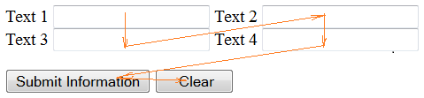
Additional Attributes of the <input> Tag
maxlength
is the maximum number of characters that are accepted as input; this is only appropriate for single-line text entry fields and password entry fields.
If this is not present, the default will be unlimited.
The text entry field will scroll appropriately if maxlength value is greater than the size value.
tabindex
tabindex="nn" - nn is a positive value - navigation proceeds from the element with the lowest tabindex value to the element with the highest value.
tabindex is a global attribute.
tabindex.html

Slide 23

Additional Attributes of the <input> Tag
disabled
disabled="disabled" - When used, cannot receive user input nor will its value be submitted to server with the form
readonly
readonly="readonly" - When used, cannot receive user input - the value is submitted to server with the form
autocomplete attribute
Specifies whether a HTML form or its form elements have autocomplete on or off.
autocomplete.html

Slide 24
HTML5 Form input Types & Attributes
HTML5 introduces many semantic input types to enrich the “text” like type.
The new input types include: email, url, tel, number, range, date, month, week, time, datatime, color, serarch
e.g.
<input type="number" name="even" min="2" max="100" step="2" />
No matter what type it is, the value is always "text".
HTML5 also supports some new attributes for form input elements.
autofocus, placeholder, required

Slide 25
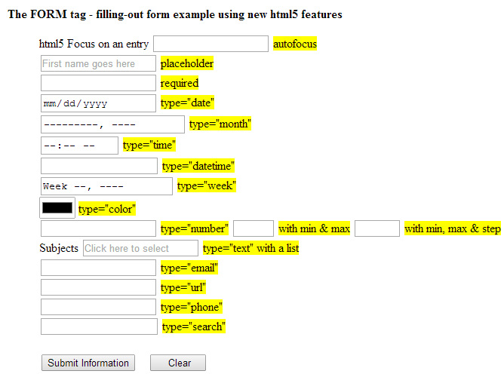
HTML5 Form input Types & Attributes
input-tags-html5.html

Slide 26
More Form Elements
In addition to <input> element, some elements can be used inside a form to accept user input:
<select> element
with <option> and <optgroup> elements
<textarea> element
<button> element

Slide 27
<select> Element
The <select> element is used to create a drop-down list, from where a user can select one or more options.
E.g.
<select name="what-to-do" id="what-to-do" size=5>
<option value="1"> Drink Coffee </option>
<option value="2" selected> Read A Book </option>
<option value="3"> Take A Walk </option>
<option value="4"> Buy A Bagel </option>
<option value="5"> Watch TV </option>
<option value="6"> Write a test </option>
</select>

Slide 28
<select> Element
The selection list itself is defined by a series of <option> tags.
The name attribute is in the <select> tag; while the value attribute is in all option tags.
If more than one option is selected in the list, the selected options are all sent to the server as a comma separated list under that one name.
select-tags-attributes.html

Slide 29
The attributes of the <select> tag
multiple="multiple"
allows users to select more than one option, usually by holding down the Control key while clicking on additional choices.
Otherwise the selection functions like radio buttons where selecting one deselects another.
size="n"
specify how many lines are displayed in the selection menu.
If the size is not specified or if size="1", a single line is displayed and the selection menu functions as a drop down menu.
If a number larger than one is specified, then the menu functions as a scrollable list.

Slide 30
<option> Element
The <option> tag is the one in a form which has “text”
value vs text
e.g. <select name=“thename”>
<option value="1">Text 1</option>
<option value="2">Text 2</option>
</select>
The value attribute is the value that is returned by selecting that option.
If a <option> tag’s value attribute is not provided, its text will be come the value.

Slide 31
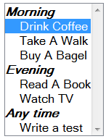
<select> Element with <optgroup>
The <optgroup> tag to group things by category.
<select name="what-to-do" id="what-to-do"
multiple="multiple" size="9">
<optgroup label="Morning">
<option value="1"
selected="selected"> Drink Coffee
</option>
<option value="2"> Take A Walk </option>
<option value="3"> Buy A Bagel </option>
</optgroup>
<optgroup label="Evening">
<option value="4"> Read A Book </option>
<option value="5"> Watch TV </option>
</optgroup>
<optgroup label="Any time">
<option value="6"> Write a test </option>
</optgroup>
</select>
select-tags-optgroup.html

Slide 32
<textarea> Element
The <textarea> element provides a multi-line text entry field.
attributes:
rows = “height of the textarea in character”
cols = “width of the textarea in character”
textarea fields automatically have scroll bars; any amount of text can be entered in them.
The element can have “text” as default contents. E.g.
<textarea name="comments" cols="30" rows="10">
Input your comments:
</textarea>
textarea.html

Slide 33
<button> Element
The <button> element provide a alternative way to perform most of the above actions with greater flexibility.
Syntax:
<button> content showing on button </button>
Type attributes:
<button type="submit">
<button type="reset">
<button type="button">
Example 1 - A button located outside a form (but still a part of the form):
<button type="submit" form="form1" value="Submit">Submit</button>
Example 2 – A button doesn’t belong to any form.
<button type="button" onclick="alert('Button was clicked!')>
Click Me!</button>

Slide 34
Grouping Fields
<fieldset> tags: grouping the fields
<legend> tags: specifying a title for the group
<fieldset>
<legend>Personal Information</legend>
Frist Name: <input type="text" name="fname" id="fanme" /><br>
Last Name: <input type="text" name="lname" id="lname" /> <br>
Email: <input type="email" name="name3" id="email" /> <br />
Telephone: <input type="tel" name="phone" id="phone" value="416-"/>
</fieldset>
fieldset-label-button.html

Slide 35
<label> Element
Define a label for <input> element.
It does not render as anything special for the user.
It provides a usability improvement for mouse users,
if the user clicks on the text within the <label> element, it toggles the control.
The for attribute of the <label> tag should be equal to the id attribute of the related element to bind them together.

Slide 36
<label> Element
Example
<h4>Label exampel 1</h4>
<div>
<label for="entry1" title="Free format">Text field 1</label>
<input type="text" name="entry1" id="entry1" />
</div>
<h4>Label exampel 2</h4>
<p>
<label for="entry3" title="Label for entry3">
<span>Text field 3 </span>
<input size="5" name="entry3" id="entry3" /> <br />
</label>
</p>
fieldset-label-button.html

Slide 37
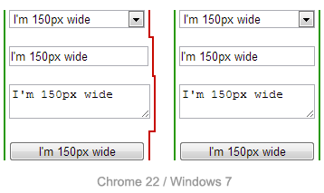
Styling HTML Forms Using CSS
Issues:
HTML table is not appropriate for aligning form elements.
Not all form elements are created equal when CSS is involved.
Some elements are easy to style with CSS, but some other elements simply can't be styled using CSS.
Browsers are often inconsistent in rending font and text.
button, input, select, textarea
{
font-family : inherit;
font-size : 100%;
width : 150px;
}

Slide 38
Styling HTML Forms Using CSS
CSS box-sizing property:
"box-sizing: border-box; " can be used to give the same size to serveral different for elements.
Example
input, textarea, select, button {
width : 150px;
margin: 0;
box-sizing: border-box;
}
CSS property “display:inline-block; “
<label> and <span> are inline-level elements, so width and height are available to them.
“display:inline-block;” can be used to inline-level elements in order to set dimensions (width and height) to them.
Example:
label { display: inline-block; width: 100px; text-align: right; }

Slide 39
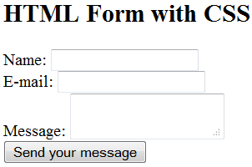
An example form with CSS
<form action="/my-handling-form-page" method="post">
<div>
<label for="name">Name:</label>
<input type="text" id="name" />
</div>
<div>
<label for="mail">E-mail:</label>
<input type="email" id="mail" />
</div>
<div>
<label for="msg">Message:</label>
<textarea id="msg"></textarea>
</div>
</form>

Slide 40
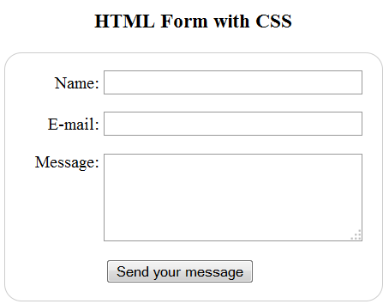
An example form with CSS
Example: form-with-css.html
After using CSS:
Here is an other example from MDN: A payment form

Slide 41
More on CSS
Attribute selector
An attribute selector will match elements on the basis of either
the presence of an attribute, or
the exact or partial match of an attribute value.
e.g.
input[type="submit"] { border: 2px solid #ccc;}
[class="warning"] { background-color: yellow; }
morecss.html

Slide 42
HTML Form Summary
Form element:
<form method="post" action="url" >
…. …
</form>
Form elements/controls:
<input> type =:
Textboxes: text, password, email, file, color, date, time, number, url, tel, …
Selections: checkbox, radio
Buttons: submit, reset, image, button
Other elements:
<select> with <option>, <textarea>, <button>.
<fieldset>, <legend>, <lable>, …

Slide 43
Advanced: More on CSS Selectors
(Notes: for “Advanced” part, read only if you’re interested in it)
Type of Selectors
Type selector (tag selector)
Class selector
ID selector
Selector grouping
Universal selector
Attribute selector
Combinators
Descendant selector (contextual selectors)
Child selector
Adjacent sibling selector
General sibling selector
Pseudo-classes
Pseudo-elements

Slide 44
Advanced: Selectors
Universal selector
The universal selector matches any element type.
e.g.
* { margin: 0; padding: 0; }
Attribute selector
An attribute selector will match elements on the basis of either
the presence of an attribute, or
the exact or partial match of an attribute value.
e.g.
[href] { color: yellow;}
a[href] {color: yellow;}
input[type="submit"] { border: 2px solid #ccc;}
[class="warning"] { background-color: yellow; }

Slide 45
Advanced: Selectors
Combinators - Selectors based on relationships
Descendant selector (contextual selectors)
e.g. div span { line-height: 90%; } // includes child
Child selector
e.g. ul>li { text-decoration: underline; }
Adjacent sibling selector
e.g. h2+p { color: blue; } // matches all p elements that appear immediately after h2 elements.
General sibling selector
e.g. h2~p { color: blue; }

Slide 46
Advanced: Selectors
Pseudo-class selector
A pseudo-class is similar to a class in HTML, but it’s not specified explicitly in the markup.
:active, :hover, :link, :visited, :focus, :first-child, …
Pseudo-element selector
allow you to style certain parts of a document:
CSS2
:after, :before, :first-letter, :first-line, :selection
CSS3
::after, ::before, ::first-letter, ::first-line, ::selection

Slide 47
Resourceful Links
W3C HTML5 DOC: Forms
MDN: Forms in HTML
How to structure an HTML form
Selectors - Web developer guide | MDN
Web Dep Tool: Firefox Style Editor
Notes:
In-browser Processing VS web app processing
Form code for web app processing
HTML forms are originally used for web app:
<!-- the user's input is sent to a web app -->
<form action="http://host.domain.com/path/to/endpoint/" method="post">
<input type="text" name="username" />
<input type="password" name="password" />
<input type="submit" value="Login" />
</form>
Form code for in-browser processing
For client-side web app, forms can be used as in-browser processing:
<!-- somewhere you will have a JavaScript function -->
<form>
<input type="text" name="username" />
<input type="password" name="password" />
<input onclick="login();" type="button" value="Login" />
</form>

Slide 48
Thank You!

